Slide 1
Name : Swapnil Ghosh Department : IT
Roll : 001911001067
TASK 1

Slide 2
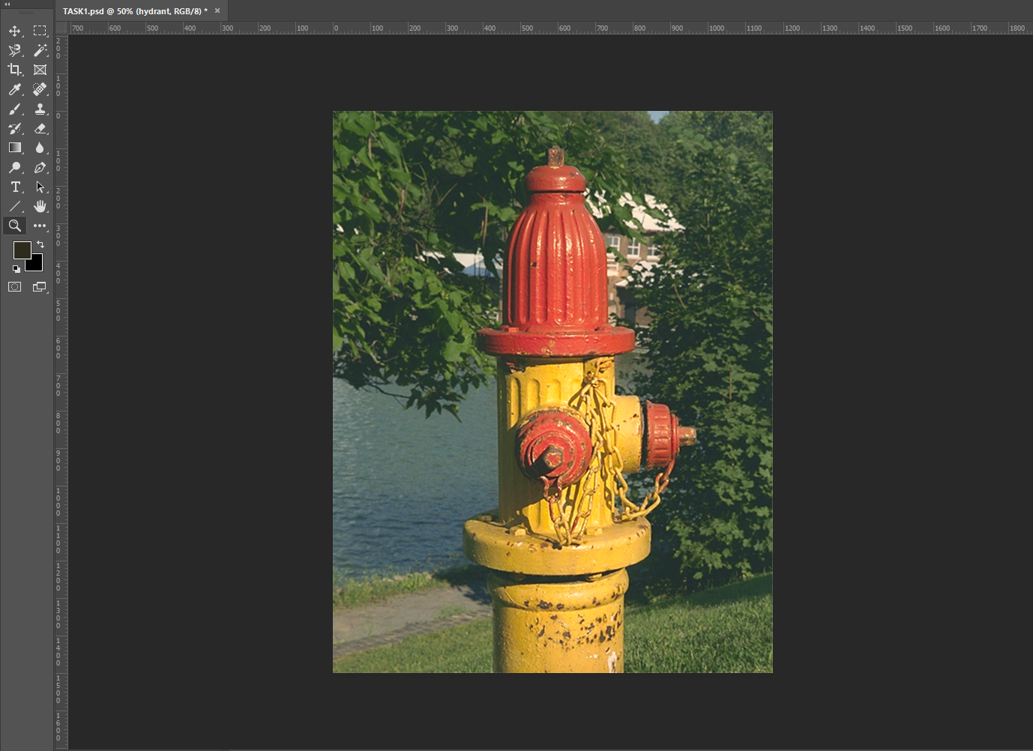
Step-1) I opened the file HYDRANT.TIF file in Photoshop
Step-2) I used a Magnetic Lasso tool to make the selection , then I created a mask of it.
Original Image

Slide 3
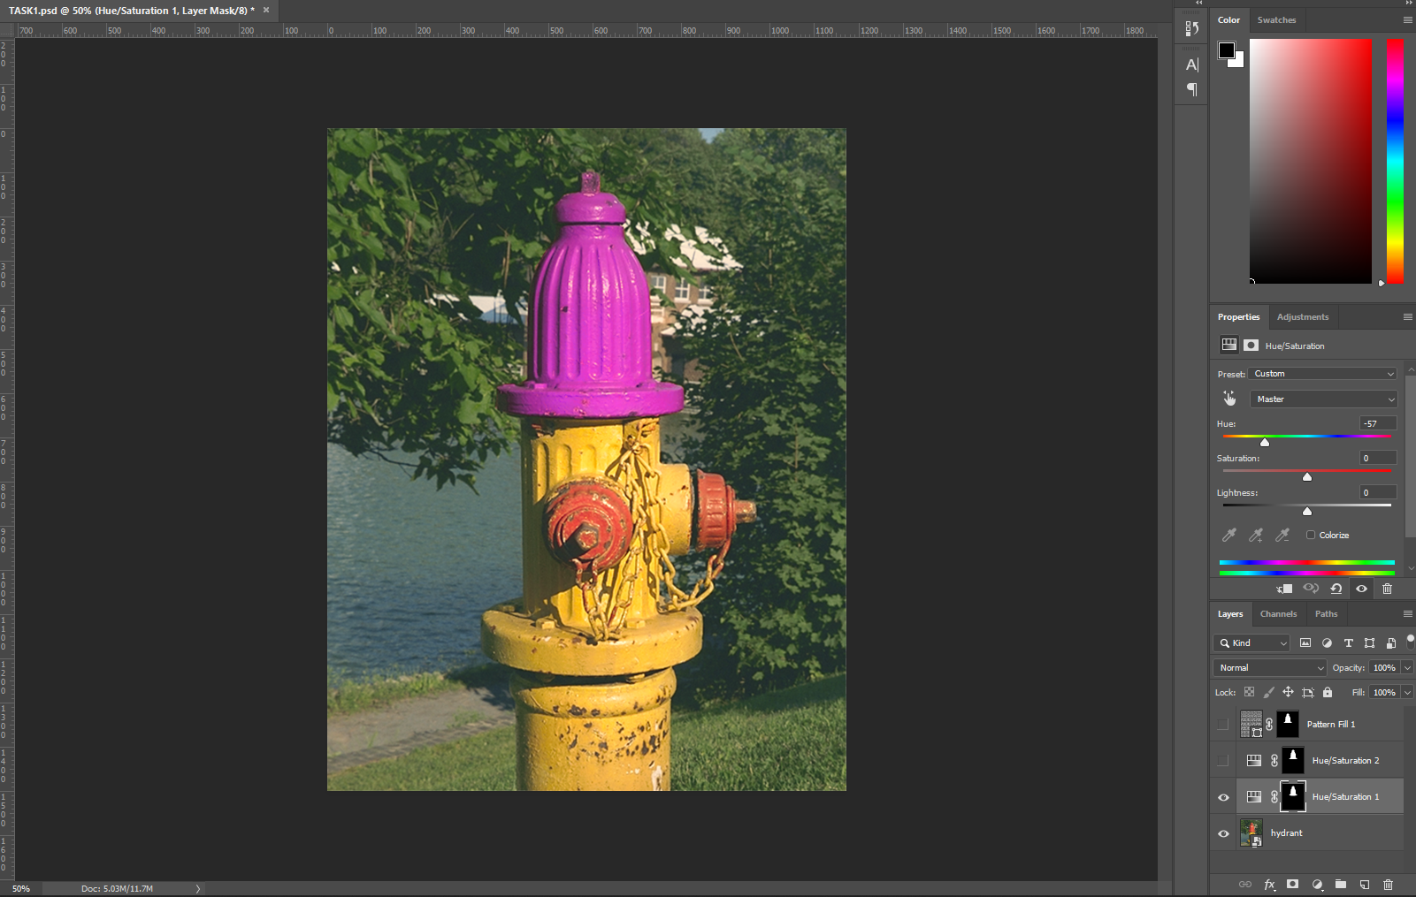
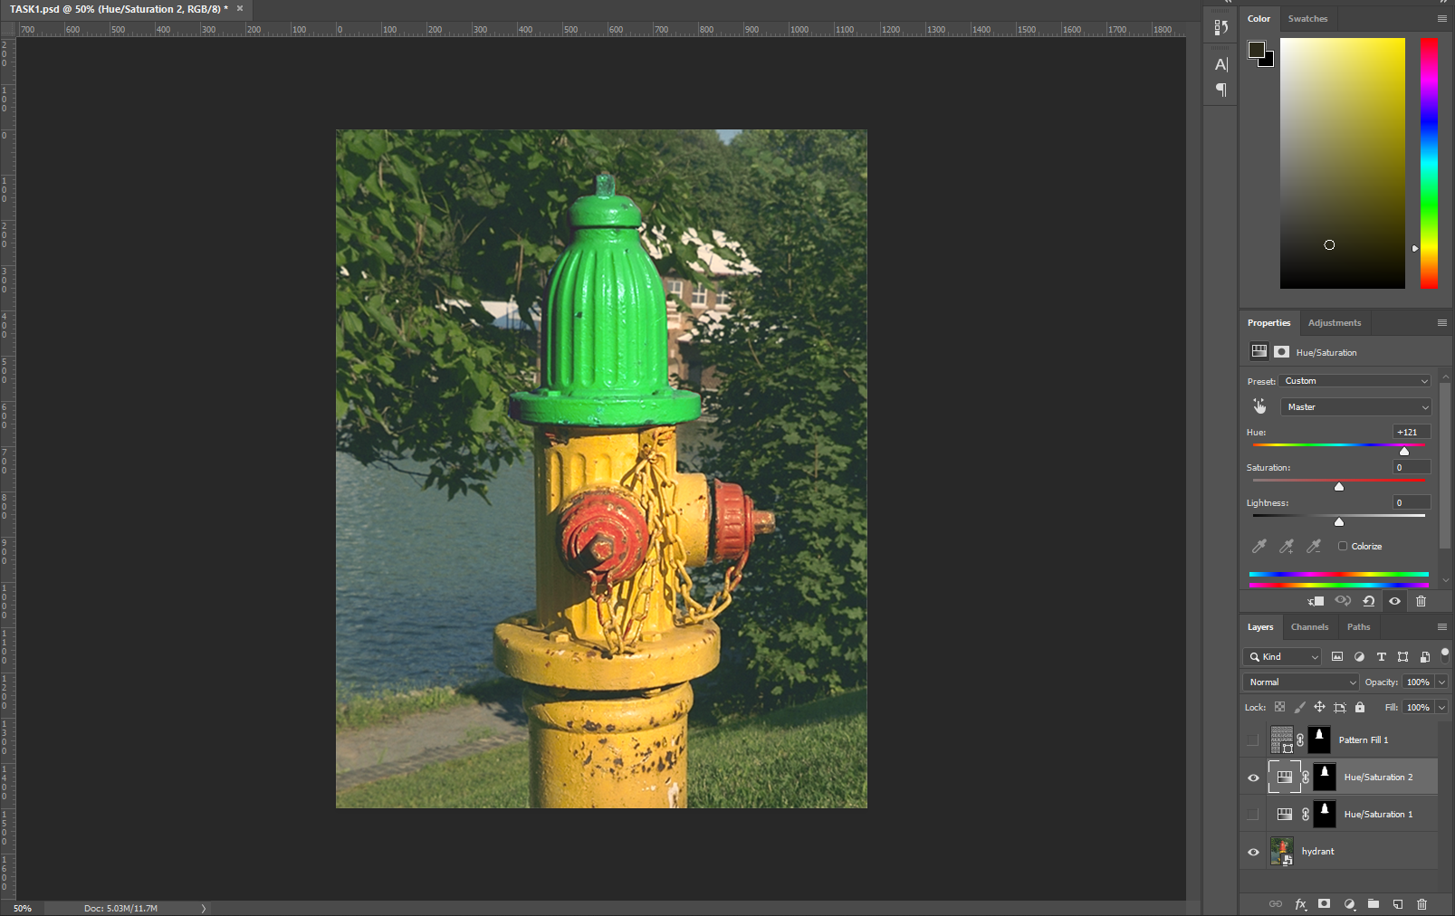
Step-3.1) Then I added a new Adjustment Layer.
Step- 4.1) In Hue/Saturation dialog box drag hue slider to -57.
Step- 4.2) In Hue/Saturation dialog box drag hue slider to +121.

Slide 4
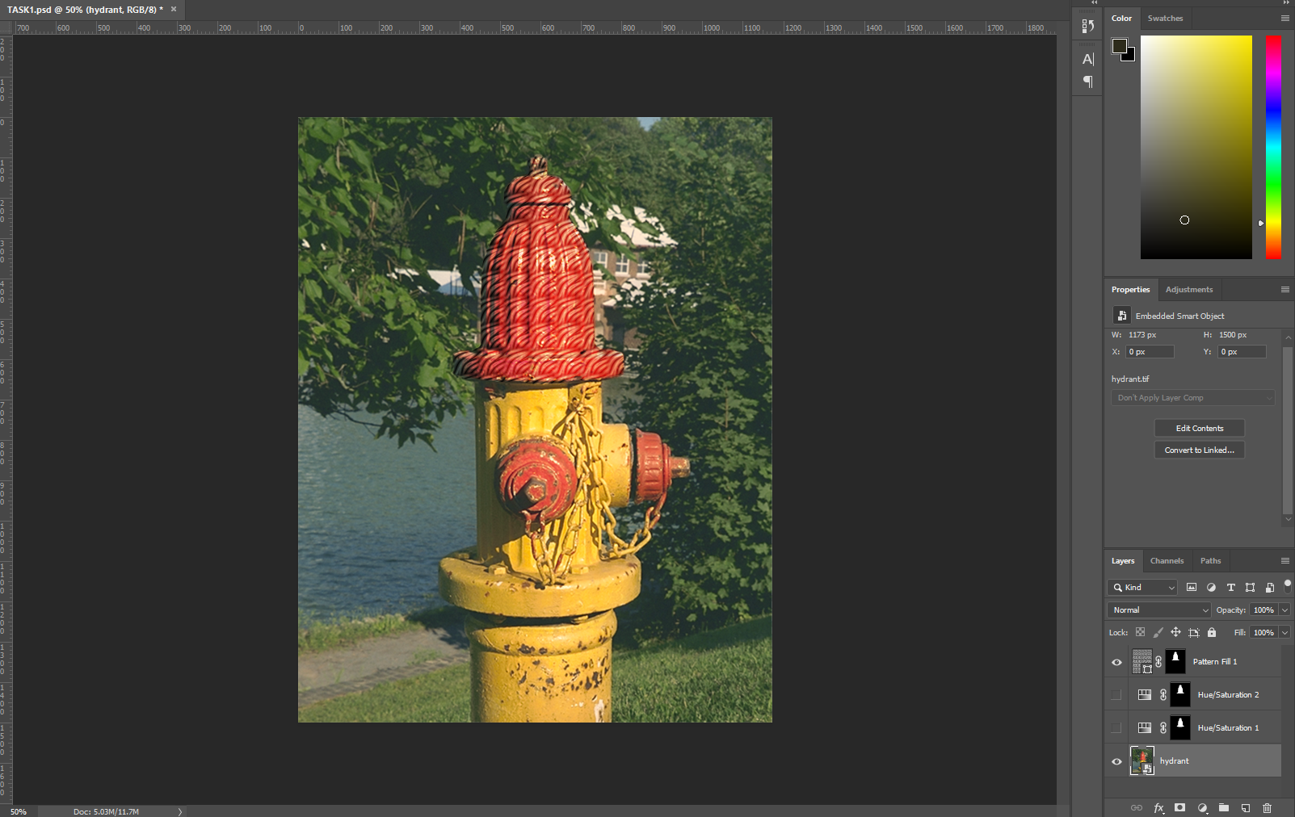
Step- 3.2) Created a new Pattern Fill Layer.
Step- 4)Changed the Bending Mode to overlay.
Step-5) In Load Pattern we used Zebra Pattern.
The End

